Slide 1

Dive into Deep Learning
Chapter 3:
Linear Neural Networks Concise Implementation of Linear Regression

Slide 2
Contents
Linear Regression
Generating the Dataset
Reading the Dataset
Concise Implementation of Linear Regression
Generating the Dataset
Implementation of Softmax Regression from Scratch
Concise Implementation of Softmax Regression
The Image Classification Dataset
Linear Regression Implementation from Scratch
Initializing Model Parameters
Defining the Model
Initializing Model Parameters
Basic Elements of Linear Regression
Vectorization for Speed
The Normal Distribution and Squared Loss
From Linear Regression to Deep Networks
Reading the Dataset
Defining the Loss Function
Reading the Dataset
Reading a Minibatch
Putting All Things Together
Initializing Model Parameters
Defining the Softmax Operation
Defining the Model
Defining the Loss Function
Initializing Model Parameters
Softmax Implementation Revisited
Optimization Algorithm
Defining the Optimization Algorithm
Softmax Regression
Classification Problem
Network Architecture
Softmax Operation
Vectorization for Minibatches
Loss Function
Information Theory Basics
Defining the Model
Defining the Loss Function
Defining the Optimization Algorithm
Training
Training
Model Prediction and Evaluation
Classification Accuracy
Training
Prediction
Training

Slide 3
Contents
CH2
Linear Regression
Linear Regression Implementation from Scratch
Concise Implementation of Linear Regression
Softmax Regression
The Image Classification Dataset
Implementation of Softmax Regression from Scratch
Concise Implementation of Softmax Regression
Basic Elements of Linear Regression
Generating the Dataset
Generating the Dataset
Classification Problem
Reading the Dataset
Initializing Model Parameters
Initializing Model Parameters
Vectorization for Speed
Reading the Dataset
Reading the Dataset
Network Architecture
Reading a Minibatch
Defining the Softmax Operation
Softmax Implementation Revisited
The Normal Distribution and Squared Loss
Initializing Model Parameters
Defining the Model
Softmax Operation
Putting All Things Together
Defining the Model
Optimization Algorithm
From Linear Regression to Deep Networks
Defining the Model
Initializing Model Parameters
Vectorization for Minibatches
Defining the Loss Function
Training
Defining the Loss Function
Defining the Loss Function
Loss Function
Classification Accuracy
Defining the Optimization Algorithm
Defining the Optimization Algorithm
Information Theory Basics
Training
Training
Training
Model Prediction and Evaluation
Prediction

Slide 4
Concise Implementation of Linear Regression
In this section, we will show you how to implement the linear regression model concisely by using high-level APIs of deep learning frameworks.

Slide 5
Contents
CH2
Linear Regression
Linear Regression Implementation from Scratch
Concise Implementation of Linear Regression
Softmax Regression
The Image Classification Dataset
Implementation of Softmax Regression from Scratch
Concise Implementation of Softmax Regression
Basic Elements of Linear Regression
Generating the Dataset
Generating the Dataset
Classification Problem
Reading the Dataset
Initializing Model Parameters
Initializing Model Parameters
Vectorization for Speed
Reading the Dataset
Reading the Dataset
Network Architecture
Reading a Minibatch
Defining the Softmax Operation
Softmax Implementation Revisited
The Normal Distribution and Squared Loss
Initializing Model Parameters
Defining the Model
Softmax Operation
Putting All Things Together
Defining the Model
Optimization Algorithm
From Linear Regression to Deep Networks
Defining the Model
Initializing Model Parameters
Vectorization for Minibatches
Defining the Loss Function
Training
Defining the Loss Function
Defining the Loss Function
Loss Function
Classification Accuracy
Defining the Optimization Algorithm
Defining the Optimization Algorithm
Information Theory Basics
Training
Training
Training
Model Prediction and Evaluation
Prediction

Slide 6
Generating the Dataset
We will generate the same dataset as in Section 3.2.
from d2l import mxnet as d2l
from mxnet import autograd, gluon, np, npx
npx.set_np()
true_w = np.array([2, -3.4])
true_b = 4.2
features, labels = d2l.synthetic_data(true_w, true_b, 1000)

Slide 7
Contents
CH2
Linear Regression
Linear Regression Implementation from Scratch
Concise Implementation of Linear Regression
Softmax Regression
The Image Classification Dataset
Implementation of Softmax Regression from Scratch
Concise Implementation of Softmax Regression
Basic Elements of Linear Regression
Generating the Dataset
Generating the Dataset
Classification Problem
Reading the Dataset
Initializing Model Parameters
Initializing Model Parameters
Vectorization for Speed
Reading the Dataset
Reading the Dataset
Network Architecture
Reading a Minibatch
Defining the Softmax Operation
Softmax Implementation Revisited
The Normal Distribution and Squared Loss
Initializing Model Parameters
Defining the Model
Softmax Operation
Putting All Things Together
Defining the Model
Optimization Algorithm
From Linear Regression to Deep Networks
Defining the Model
Initializing Model Parameters
Vectorization for Minibatches
Defining the Loss Function
Training
Defining the Loss Function
Defining the Loss Function
Loss Function
Classification Accuracy
Defining the Optimization Algorithm
Defining the Optimization Algorithm
Information Theory Basics
Training
Training
Training
Model Prediction and Evaluation
Prediction

Slide 8
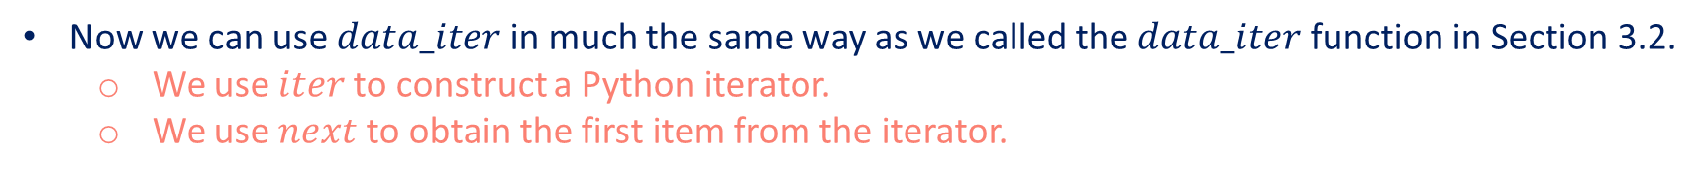
Reading the Dataset
Use the existing API in a framework to read data.
We pass in $features$ and $labels$ as arguments and specify batch_size when instantiating a data iterator object.
The boolean value $is_train$ indicates whether or not to shuffle the data on each epoch.
def load_array(data_arrays, batch_size, is_train=True): #@save
"""Construct a Gluon data iterator."""
dataset = gluon.data.ArrayDataset(*data_arrays)
return gluon.data.DataLoader(dataset, batch_size, shuffle=is_train)
batch_size = 10
data_iter = load_array((features, labels), batch_size)
Now we can use $data_iter$ in much the same way as we called the $data_iter$ function in Section 3.2.
We use $iter$ to construct a Python iterator.
We use $next$ to obtain the first item from the iterator.
next(iter(data_iter))

Slide 9
Contents
CH2
Linear Regression
Linear Regression Implementation from Scratch
Concise Implementation of Linear Regression
Softmax Regression
The Image Classification Dataset
Implementation of Softmax Regression from Scratch
Concise Implementation of Softmax Regression
Basic Elements of Linear Regression
Generating the Dataset
Generating the Dataset
Classification Problem
Reading the Dataset
Initializing Model Parameters
Initializing Model Parameters
Vectorization for Speed
Reading the Dataset
Reading the Dataset
Network Architecture
Reading a Minibatch
Defining the Softmax Operation
Softmax Implementation Revisited
The Normal Distribution and Squared Loss
Initializing Model Parameters
Defining the Model
Softmax Operation
Putting All Things Together
Defining the Model
Optimization Algorithm
From Linear Regression to Deep Networks
Defining the Model
Initializing Model Parameters
Vectorization for Minibatches
Defining the Loss Function
Training
Defining the Loss Function
Defining the Loss Function
Loss Function
Classification Accuracy
Defining the Optimization Algorithm
Defining the Optimization Algorithm
Information Theory Basics
Training
Training
Training
Model Prediction and Evaluation
Prediction

Slide 10
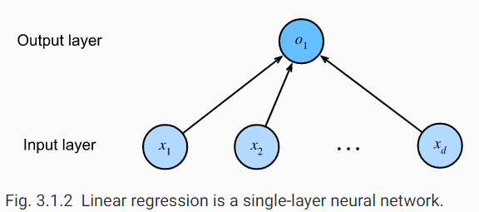
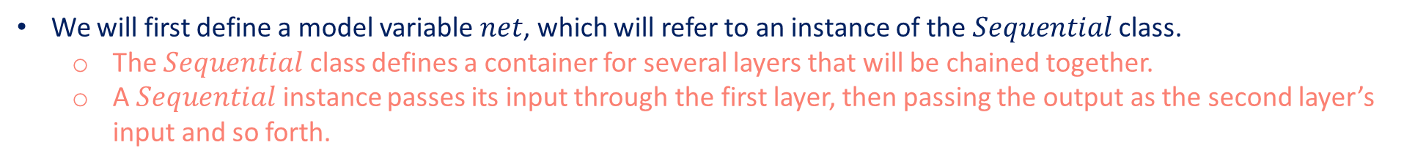
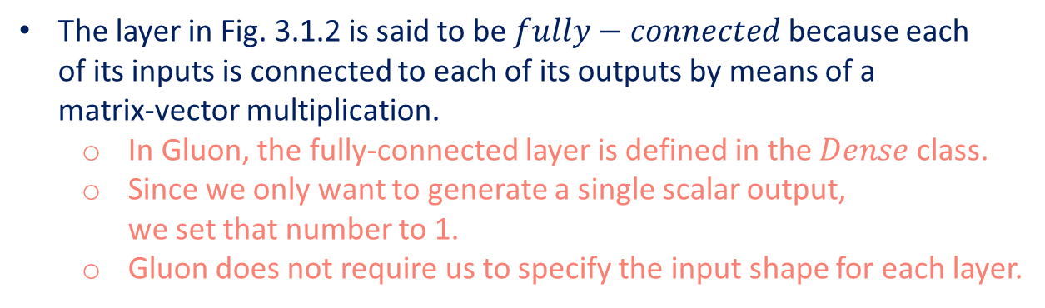
Defining the Model
We use a framework’s predefined layers to focus on the layers used to construct the model rather than focusing on the implementation.
We will first define a model variable $net$, which will refer to an instance of the $Sequential$ class.
The $Sequential$ class defines a container for several layers that will be chained together.
A $Sequential$ instance passes its input through the first layer, then passing the output as the second layer’s input and so forth.
The layer in Fig. 3.1.2 is said to be $fully−connected$ because each of its inputs is connected to each of its outputs by means of a matrix-vector multiplication.
In Gluon, the fully-connected layer is defined in the $Dense$ class.
Since we only want to generate a single scalar output, we set that number to 1.
Gluon does not require us to specify the input shape for each layer.
# `nn` is an abbreviation for neural networks
from mxnet.gluon import nn
net = nn.Sequential()
net.add(nn.Dense(1))

Slide 11
Contents
CH2
Linear Regression
Linear Regression Implementation from Scratch
Concise Implementation of Linear Regression
Softmax Regression
The Image Classification Dataset
Implementation of Softmax Regression from Scratch
Concise Implementation of Softmax Regression
Basic Elements of Linear Regression
Generating the Dataset
Generating the Dataset
Classification Problem
Reading the Dataset
Initializing Model Parameters
Initializing Model Parameters
Vectorization for Speed
Reading the Dataset
Reading the Dataset
Network Architecture
Reading a Minibatch
Defining the Softmax Operation
Softmax Implementation Revisited
The Normal Distribution and Squared Loss
Initializing Model Parameters
Defining the Model
Softmax Operation
Putting All Things Together
Defining the Model
Optimization Algorithm
From Linear Regression to Deep Networks
Defining the Model
Initializing Model Parameters
Vectorization for Minibatches
Defining the Loss Function
Training
Defining the Loss Function
Defining the Loss Function
Loss Function
Classification Accuracy
Defining the Optimization Algorithm
Defining the Optimization Algorithm
Information Theory Basics
Training
Training
Training
Model Prediction and Evaluation
Prediction

Slide 12

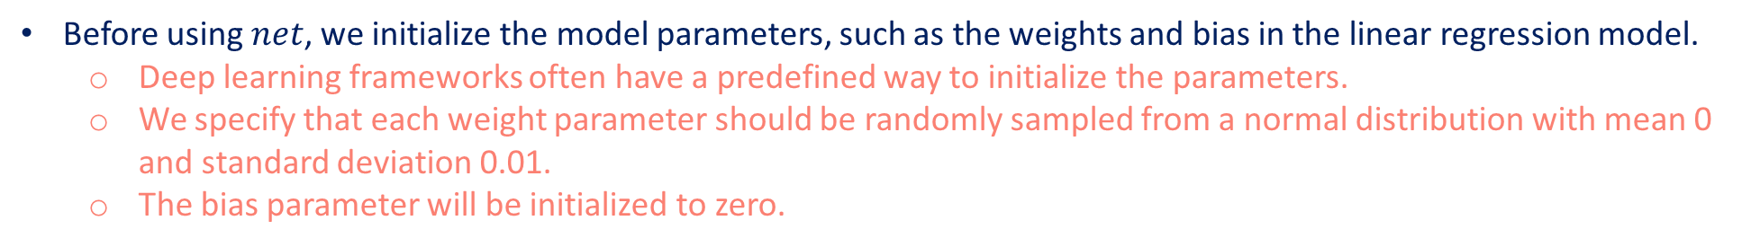
Initializing Model Parameters
Before using $net$, we initialize the model parameters, such as the weights and bias in the linear regression model.
Deep learning frameworks often have a predefined way to initialize the parameters.
We specify that each weight parameter should be randomly sampled from a normal distribution with mean 0 and standard deviation 0.01.
The bias parameter will be initialized to zero.
We will import the $initializer$ module from MXNet.
Bias parameters are initialized to zero by default.
from mxnet import init
net.initialize(init.Normal(sigma=0.01))
Note that we are initializing parameters for a network even though Gluon does not yet know how many dimensions the input will have! It might be 2 as in our example or it might be 2000.
Gluon lets us get away with this because behind the scene, the initialization is actually deferred.
The real initialization will take place only when we for the first time attempt to pass data through the network.

Slide 13
Contents
CH2
Linear Regression
Linear Regression Implementation from Scratch
Concise Implementation of Linear Regression
Softmax Regression
The Image Classification Dataset
Implementation of Softmax Regression from Scratch
Concise Implementation of Softmax Regression
Basic Elements of Linear Regression
Generating the Dataset
Generating the Dataset
Classification Problem
Reading the Dataset
Initializing Model Parameters
Initializing Model Parameters
Vectorization for Speed
Reading the Dataset
Reading the Dataset
Network Architecture
Reading a Minibatch
Defining the Softmax Operation
Softmax Implementation Revisited
The Normal Distribution and Squared Loss
Initializing Model Parameters
Defining the Model
Softmax Operation
Putting All Things Together
Defining the Model
Optimization Algorithm
From Linear Regression to Deep Networks
Defining the Model
Initializing Model Parameters
Vectorization for Minibatches
Defining the Loss Function
Training
Defining the Loss Function
Defining the Loss Function
Loss Function
Classification Accuracy
Defining the Optimization Algorithm
Defining the Optimization Algorithm
Information Theory Basics
Training
Training
Training
Model Prediction and Evaluation
Prediction

Slide 14
Defining the Loss Function
In Gluon, the $loss$ module defines various loss functions.
In this example, we will use the Gluon implementation of squared loss ($L2Loss$).
loss = gluon.loss.L2Loss()

Slide 15
Contents
CH2
Linear Regression
Linear Regression Implementation from Scratch
Concise Implementation of Linear Regression
Softmax Regression
The Image Classification Dataset
Implementation of Softmax Regression from Scratch
Concise Implementation of Softmax Regression
Basic Elements of Linear Regression
Generating the Dataset
Generating the Dataset
Classification Problem
Reading the Dataset
Initializing Model Parameters
Initializing Model Parameters
Vectorization for Speed
Reading the Dataset
Reading the Dataset
Network Architecture
Reading a Minibatch
Defining the Softmax Operation
Softmax Implementation Revisited
The Normal Distribution and Squared Loss
Initializing Model Parameters
Defining the Model
Softmax Operation
Putting All Things Together
Defining the Model
Optimization Algorithm
From Linear Regression to Deep Networks
Defining the Model
Initializing Model Parameters
Vectorization for Minibatches
Defining the Loss Function
Training
Defining the Loss Function
Defining the Loss Function
Loss Function
Classification Accuracy
Defining the Optimization Algorithm
Defining the Optimization Algorithm
Information Theory Basics
Training
Training
Training
Model Prediction and Evaluation
Prediction

Slide 16
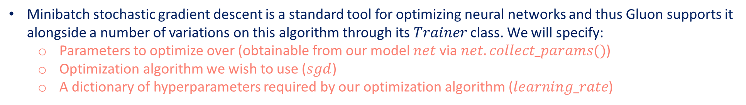
Defining the Optimization Algorithm
Minibatch stochastic gradient descent is a standard tool for optimizing neural networks and thus Gluon supports it alongside a number of variations on this algorithm through its $Trainer$ class. We will specify:
Parameters to optimize over (obtainable from our model $net$ via $net.collect_params()$)
Optimization algorithm we wish to use ($sgd$)
A dictionary of hyperparameters required by our optimization algorithm ($learning_rate$)
from mxnet import gluon
trainer = gluon.Trainer(net.collect_params(), 'sgd', {'learning_rate': 0.03})

Slide 17
Contents
CH2
Linear Regression
Linear Regression Implementation from Scratch
Concise Implementation of Linear Regression
Softmax Regression
The Image Classification Dataset
Implementation of Softmax Regression from Scratch
Concise Implementation of Softmax Regression
Basic Elements of Linear Regression
Generating the Dataset
Generating the Dataset
Classification Problem
Reading the Dataset
Initializing Model Parameters
Initializing Model Parameters
Vectorization for Speed
Reading the Dataset
Reading the Dataset
Network Architecture
Reading a Minibatch
Defining the Softmax Operation
Softmax Implementation Revisited
The Normal Distribution and Squared Loss
Initializing Model Parameters
Defining the Model
Softmax Operation
Putting All Things Together
Defining the Model
Optimization Algorithm
From Linear Regression to Deep Networks
Defining the Model
Initializing Model Parameters
Vectorization for Minibatches
Defining the Loss Function
Training
Defining the Loss Function
Defining the Loss Function
Loss Function
Classification Accuracy
Defining the Optimization Algorithm
Defining the Optimization Algorithm
Information Theory Basics
Training
Training
Training
Model Prediction and Evaluation
Prediction

Slide 18
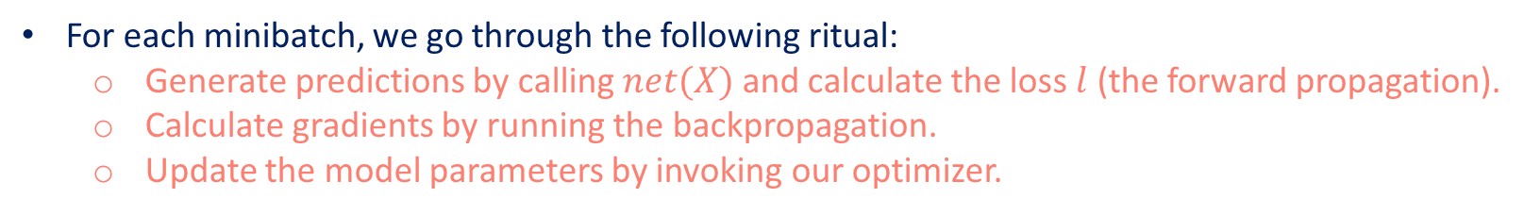
Training
For each minibatch, we go through the following ritual:
Generate predictions by calling $net(X)$ and calculate the loss $l$ (the forward propagation).
Calculate gradients by running the backpropagation.
Update the model parameters by invoking our optimizer.
num_epochs = 3
for epoch in range(num_epochs):
for X, y in data_iter:
with autograd.record():
l = loss(net(X), y)
l.backward()
trainer.step(batch_size)
l = loss(net(features), labels)
print(f'epoch {epoch + 1}, loss {l.mean().asnumpy():f}')
We compare the model parameters learned by training and the actual parameters that generated our dataset.
w = net[0].weight.data()
print(f'error in estimating w: {true_w - w.reshape(true_w.shape)}')
b = net[0].bias.data()
print(f'error in estimating b: {true_b - b}')

Slide 19
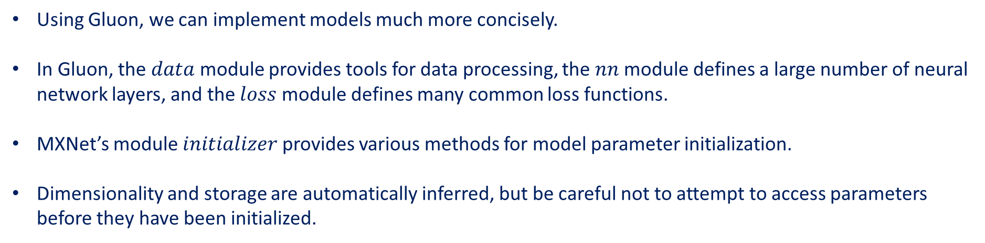
Summary
Using Gluon, we can implement models much more concisely.
In Gluon, the $data$ module provides tools for data processing, the $nn$ module defines a large number of neural network layers, and the $loss$ module defines many common loss functions.
MXNet’s module $initializer$ provides various methods for model parameter initialization.
Dimensionality and storage are automatically inferred, but be careful not to attempt to access parameters before they have been initialized.

